Slide 1
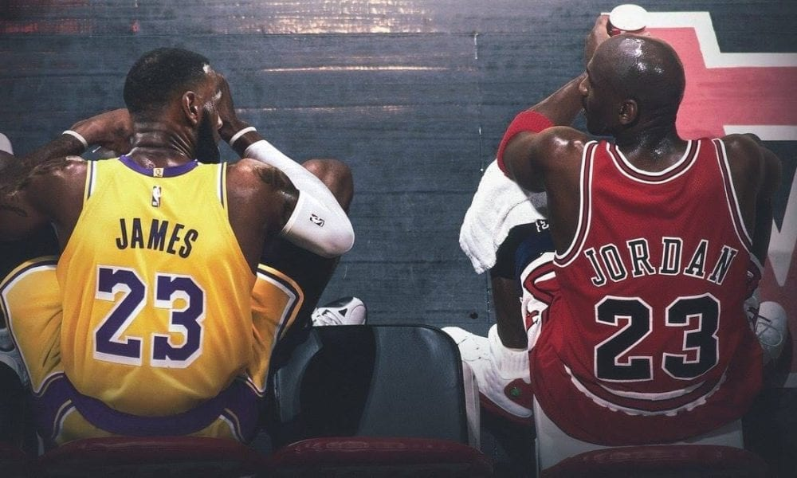
Who’s The Real MVP? MJ vs. Lebron
Capstone Project for Part Time Data Analytics Cohort DA5.
By
Austin Peay

Slide 2
Data Sources
This project will be using data published by Basketball Reference.
Data tools used include:
Excel
Power Bi
Python

Slide 3
Challenges?
Having a large amount of Data.
The Scrapper Package I used in Python grabbed the individual players data by year.
Cleaning became tedious with having 20+ tabs in Excel.

Slide 4
Data Questions?
The Goat? This question has been brewing around ever since Lebron James won his first championship. Is Michael Jordan the greatest of all time or is Lebron James the greatest of all time?
Did teammates affect the individual's performance?

Slide 5
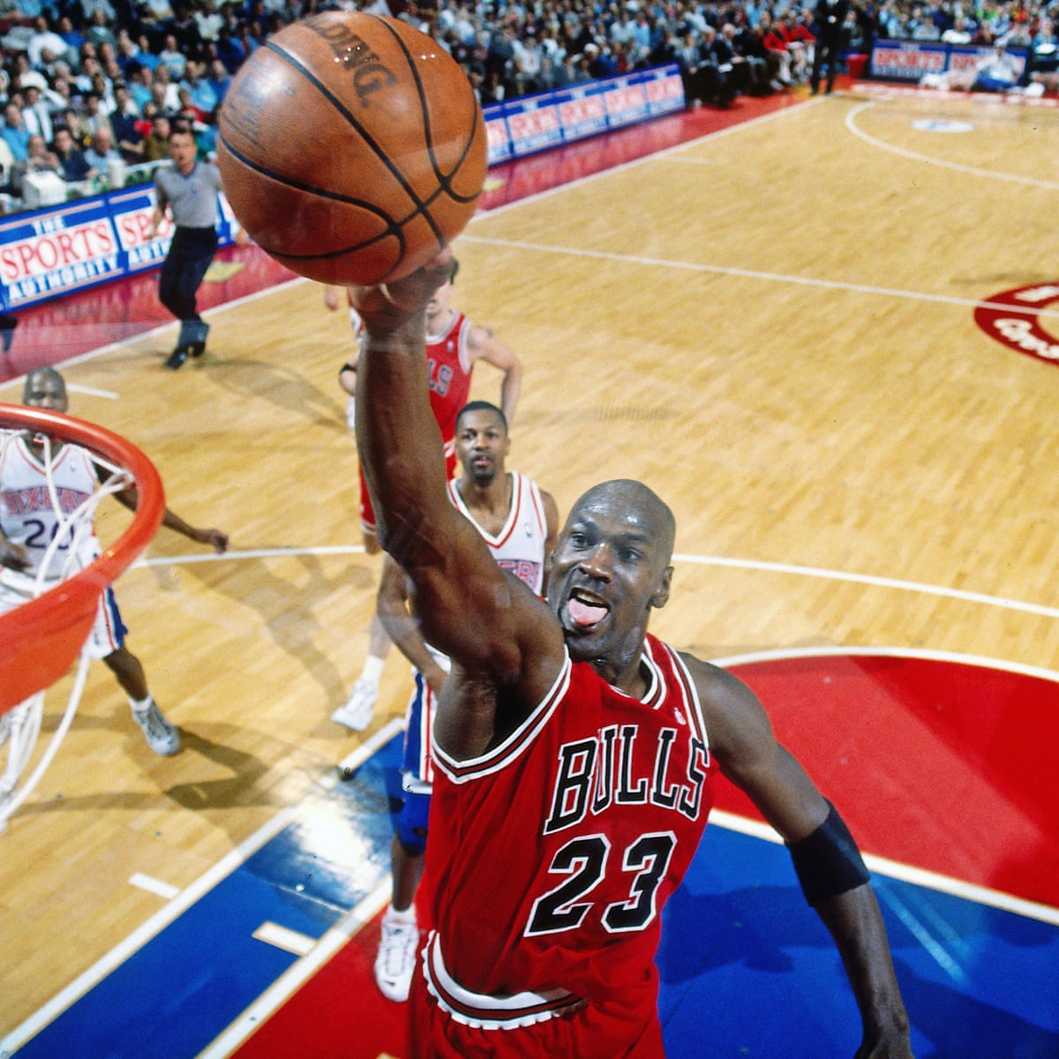
Who is Michael Jordan?
6x NBA Champion and 6x NBA Finals MVP
Having won 3 championships in a row
5x NBA MVP
14x NBA All-Star
2x Olympic gold medal winner

Slide 6
Michael Jordan Cont.
NBA Rookie of the Year
10x NBA scoring leader
3x NBA All-Star Game MVP
10x All-NBA First Team
9x NBA All-Defensive First Team
2x NBA Slam Dunk Contest Champion
Current partial owner of the Charlotte Hornets
Class of 2019 Hall of Fame
At the end of 2019, it was estimated that the Nike Air Jordan brand was worth 3bn dollars

Slide 7
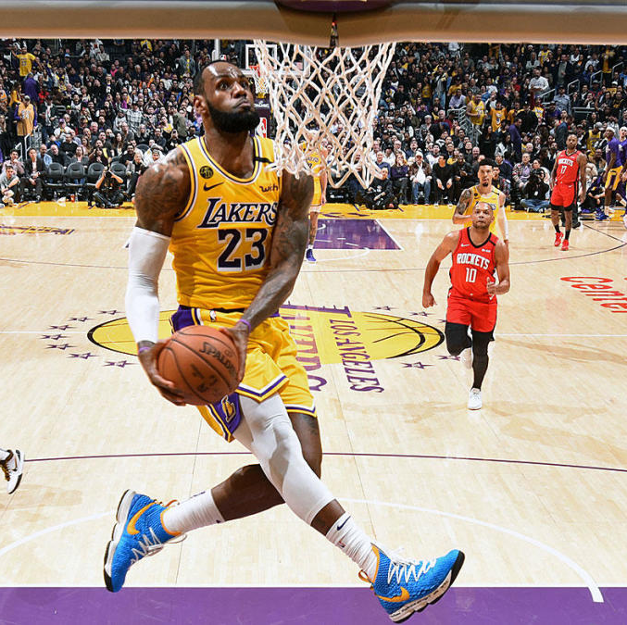
Who is LeBron James?
4x NBA Champion and 4x Finals MVP
4x NBA MVP
17x NBA All-Star
2x Olympic gold medal winner
3x NBA All-Star Game MVP
5x NBA All-Defensive First Team
NBA rookie of the Year

Slide 8
LeBron James Cont.
NBA scoring leader in 2008
NBA assists leader in 2020
3x NBA minutes Leader.
Charity
Through its I PROMISE program, the foundation serves more than 1,400 Akron-area students by providing them with the programs, support, and mentors they need to succeed in school and beyond.
https://www.lebronjamesfamilyfoundation.org/

Slide 9
Dashboard
https://app.powerbi.com/groups/me/reports/930cd2e1-5d65-4328-a2c9-d8e3f44bd40f/ReportSectionb7cbee2159a3e0190e65

Slide 10
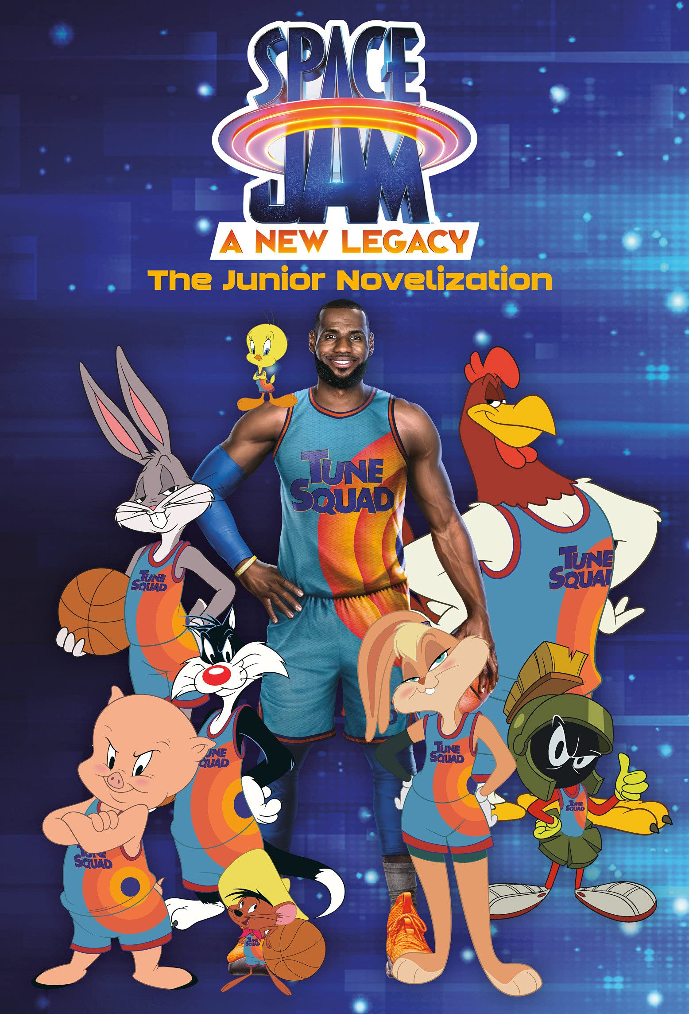
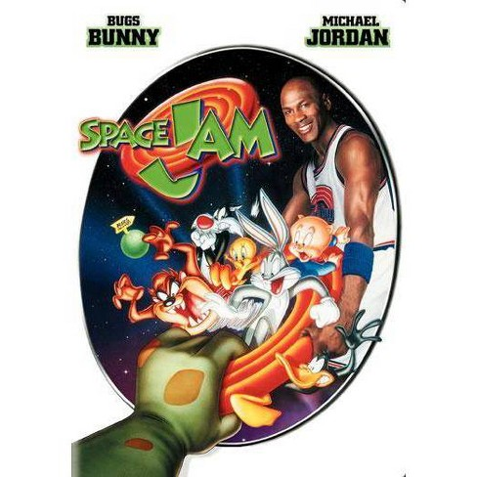
Acting?

Slide 11
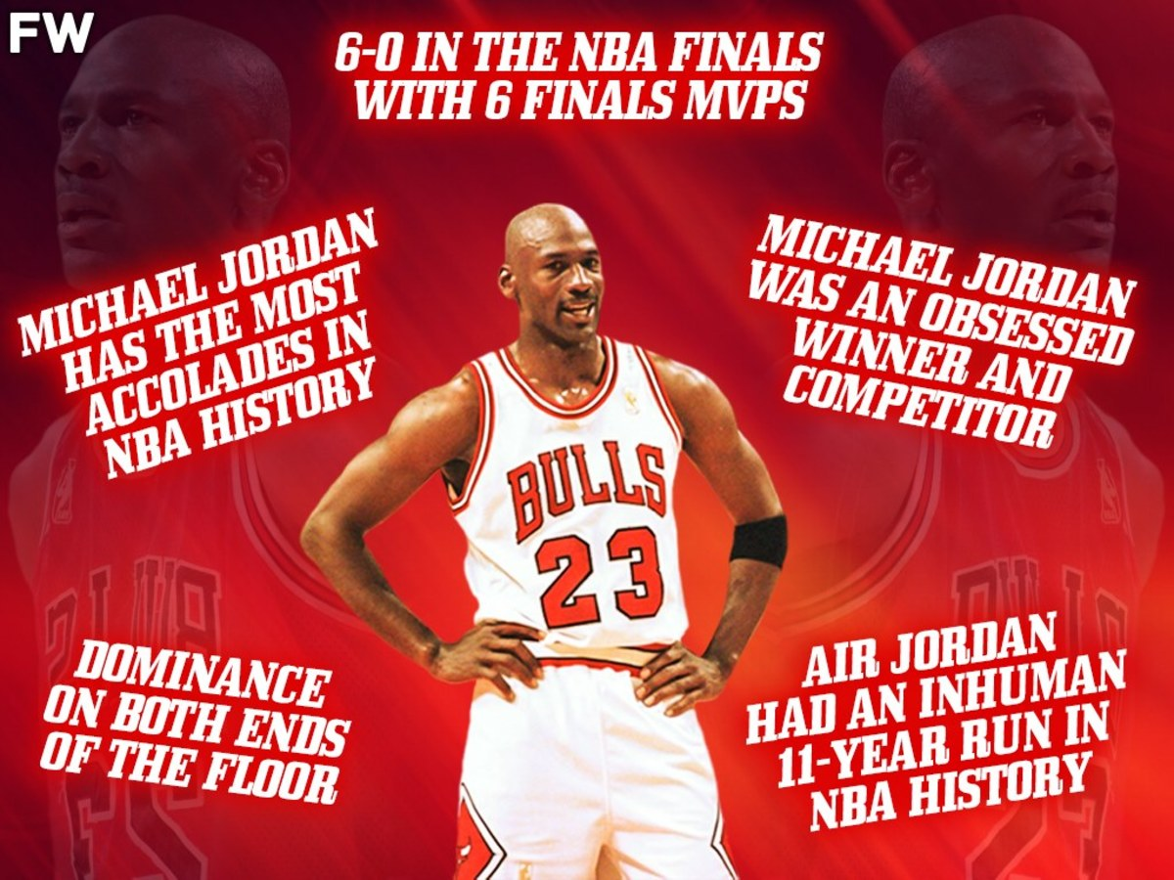
So, Who’s The Goat?

